Slide 1


Embedded AVR Workshop
Session
2
C Programming

Slide 2



Hello!
Instructor: Abd-El Wadoud Ahmad (MTI, CS)
abdelwadoud299@gmail.com
Instructor: Marwan Alaa
marwanalaamohammed@gmail.com.

Slide 3
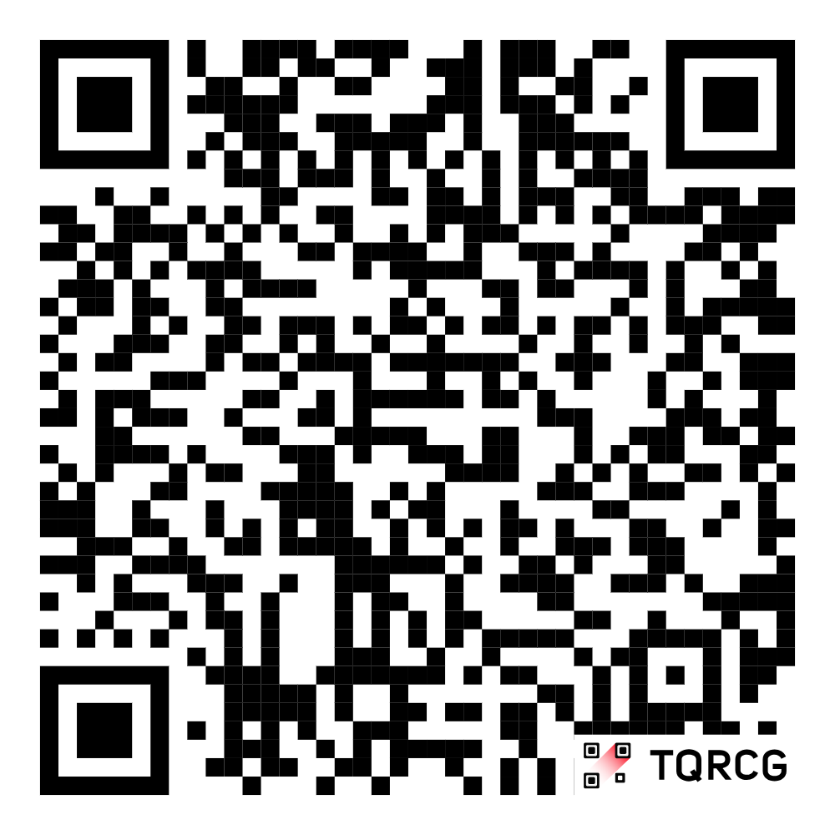

Slide 4
Content
C Introduction
Breaking “Hello World”
Data Types & Operators
If & Switch Statements
For & While Loops
Bitwise Operations
Git Vs GitHub

Slide 5

C How to Program
Quick History
Mother of all Programming Languages

Slide 6

What’s Programming?
Dictionary: the process or activity of writing computer programs.
Coursera: refers to the act of using different languages to communicate with and instruct computers
W3School: is telling a computer what to do.

Slide 7
History of Programming
1949
1991
Assembly Language
-Kathleen Booth
Python
-Guido van Rossum
1883
1972
2006
Algorithm for the Analytical Engine
-Ada Lovelace
C
-Dennis Ritchie
Rust
-Graydon Hoare

Slide 8
So why C?
General-Purpose Programming Language (GPL)
Not Domain-Specific Programming Language (DSL)
Imperative Procedural Language (Programming Paradigm)
Not Declarative Functional
Statically Typed
Not Dynamically Typed
Efficiency, Direct Hardware Interaction
Low-level Programming, Real-time Operations

Slide 9
printf(“Hello World”);
Basic Programming
Every Programmer’s First Program

Slide 10
Printing “Hello World”
#include <stdio.h>
int main() {
printf("Hello World!");
return 0;
}
<-- Library
<-- Main function
<-- Statement
<-- Exit Program

Slide 11
Data Types & Operators
Calculating Programming
Hey wanna build your OWN calculator instead?

Slide 12
Data Types
Data Type | Size | Description | Format Specifier | Example
int | 2 or 4 bytes | Stores whole numbers | %d or %i | 3
float | 4 bytes | Stores fractional numbers. Sufficient for storing 6 decimal digits | %f or %F | 3.2
double | 8 bytes | Stores fractional numbers. Sufficient for storing 15 decimal digits | %lf | 3.22222222
char | 1 byte | Stores a single character, following ASCII values | %c or %s (string) | ’w’

Slide 13
Extended Types
Extend Type | Size | Range | Format Specifier
int | 2 or 4 bytes | -32768 to 32767 (2bytes) Or -2,147,483,648 to 2,147,483,647 (4bytes) | %d or %i
unsigned Int | 2 or 4 bytes | 0 to 65,535 (2 bytes) Or 0 to 4,294,967,295 (4bytes) | %u
short Int | 2 bytes | -32,768 to 32,767 | %hd
long Int | 4 or 8 bytes | -2,147,483,648 to 2,147,483,647 (4 bytes) Or -9,223,372,036,854,775,808 to 9,223,372,036,854,775,807 (8 bytes) | %ld

Slide 14
The Cure <stdint.h>
Data Type | Size | Range
uint8_t | 1 byte | 0 .. 255
int8_t | 1 byte | -128 .. 127
uint16_t | 2 bytes | 0.. 65535
uint32_t | 4 bytes | 0 .. 4,294,967,295

Slide 15
Declaration
#include <stdint.h>
#include <stdio.h>
void main() {
int value = -32
float pi = 3.14
char grade = 'B'
uint8_t counter = 255;
uint16_t timer_value = 1000;
uint64_t XL = 18446744073709551615;
}

Slide 16
Operators: Arithmetic
Operator | Name | Example
+ | Addition | 2 + 3 = 5
- | Subtraction | 39 – 23 = 16
* | Multiplication | 10 * 10 = 100
/ | Division | 100 / 10 = 10
% | Modulus | 16 % 15 = 1
++ | Increment | 100++ = 101
-- | Decrement | 68-- = 67

Slide 17
Operators: Comparison
Operator | Name | Example
== | Equal | 3 == 3
!= | Not Equal | 3 != 4
> | Greater than | 4 > 3
< | Less than | 3 < 4
>= | Equal or Great than | 4 >= 3
<= | Equal or Less than | 3 <= 3

Slide 18
Operators: Logical
Operator | Name | Example
&& | AND | x < 5 && x < 10
|| | OR | x < 5 || x < 4
! | NOT | !(x < 5 && x < 10)

Slide 19
Operators: Assignment
To assign a value to any variable, we use equal ‘=‘
By combining Equal with any operator from Arithmetic or Logical we get assignment operators with properties of other operator
i.e. x /= 3 is the same as x = x / 3
Basically, a shorter way of writing Assignments

Slide 20
Operators in practice
void main() {
uint8_t x = 7;
uint8_t y = 30;
uint8_t z;
z = x % y;
printf("x %% y = %d\n", z);
z = x > y;
printf("x > y = %d\n", z);
z = x && y;
printf("x && y = %d\n", z);
}
x % y = 7
x > y = 0
x && y = 1

Slide 21
Conditionals
Control Flow
If you do then good, else then bad

Slide 22
If Statement
Use if to specify a block of code to be executed, if a specified condition is true
Use else to specify a block of code to be executed, if the same condition is false
Use else if to specify a new condition to test, if the first condition is false
Use switch to specify many alternative blocks of code to be executed

Slide 23
What if we demonstrate?
void main() {
int age = 30;
if (age < 18) {
printf("You are a school student.\n");
} else if (age >= 18 && age < 24) {
printf("You are a university student.\n");
} else {
printf("You are a graduate.\n");
}
}

Slide 24
Nested If
int age = 30;
if (age < 18) {
if (age < 13) {
printf("You are a child.\n");
} else {
printf("You are a teenager.\n");
}
} else {
printf("You are an adult.\n");
}
You can also place an if statement inside another if. This is called a nested if statement.
A nested if lets you check for a condition only if another condition is already true

Slide 25
How does Switch work?
switch (day) {
case 1:
printf("Monday");
break;
case 2:
printf("Tuesday");
break;
case 3:
printf("Wednesday");
break;
default:
printf("Invalid day");
}
The value of the expression is compared with the values of each case
If there is a match, the associated block of code is executed
The break statement breaks out of the switch block and stops the execution
The default statement is optional, and specifies some code to run if there is no case match

Slide 26
Loops
Loops
Loops

Slide 27
What is a loop?
Loops can execute a block of code as long as a specified condition is true.
Loops are handy because they save time, reduce errors, and they make code more readable.

Slide 28
While
while (1) {
printf("Hello, World!\n");
}
The while loop repeats a block of code as long as a specified condition is true

Slide 29
Do While
do {
printf("Hello, World!\n");
} while (0);
This loop will execute the code block once, before checking if the condition is true, then it will repeat the loop as long as the condition is true.

Slide 30
For
for (int i = 0; i < 10; i++) {
printf("Hello, World!\n");
}
When you know exactly how many times you want to loop through a block of code, use the For loop instead of a while loop:

Slide 31
GitHub
Version Control
Managing Your Projects

Slide 32
What’s Version Control?
the task of keeping a software system consisting of many versions and configurations well organized
Version control systems help developers keep a complete code history by tracking changes
Examples: Git, Subversion, Mercurial

Slide 33
Git Vs GitHub
the task of keeping a software system consisting of many versions and configurations well organized
Version control systems help developers keep a complete code history by tracking changes
Examples: Git, Subversion, Mercurial

Slide 34
Thank You!
Any questions?

